Slide 1
Expanded data
x₅ = 1 – (x₁ – x₂ - x₃ – x₄) → not related to the chemistry
w = x₂ / x₃ + x₄ → related to the ratio of the chemistry
z = x₁ + x₂ / x₄ + x₅ → related to the ratio of the chemistry
t = v1 * v2 → related to the product of the process

Slide 2
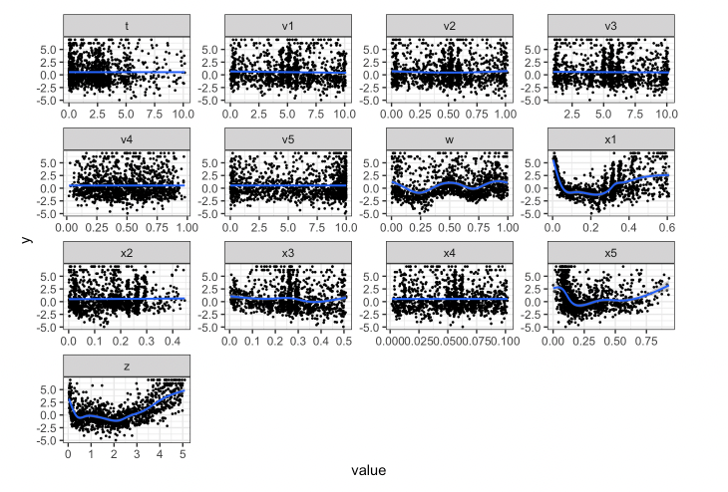
Find the relationships in each variables

Slide 3
Find the relationships in each variables
These 3 variables seem to have quadratic relationships to the y

Slide 4
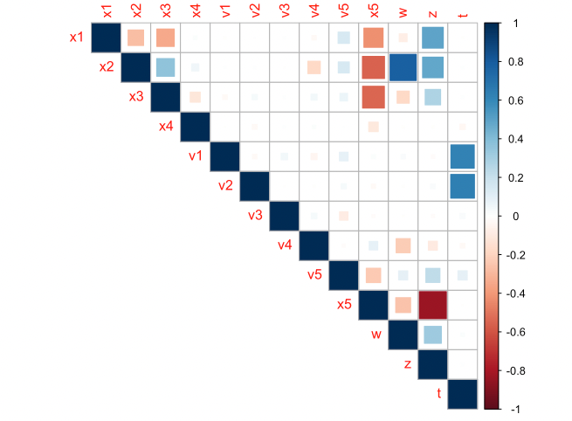
Find the relationships in each variables
From this chart,
we can find there is relationships between z, x5, and t

Slide 5
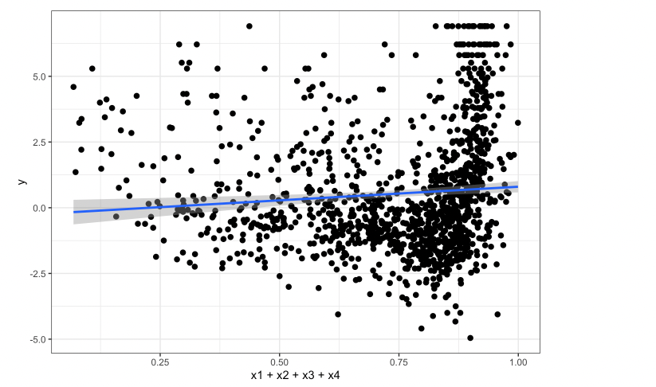
Find the relationships in each variables
And there is also relationships between y and (x1 + x2 + x3 + x4)

Slide 6
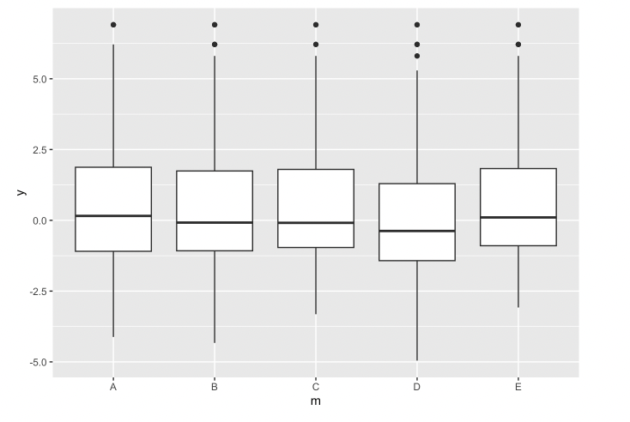
Find the relationships in each variables
There is no significant relationships between the machines

Slide 7
The discoveries above can be references when creating the models later.
Those relationships could become different formulas in the model.

Slide 8
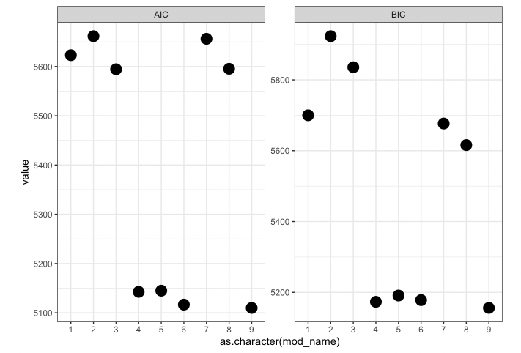
Regression model
Linear models
Since the value of the AIC and BIC the smaller the better, the better model here is:
model_04, model_05, model_06, and model_09

Slide 9
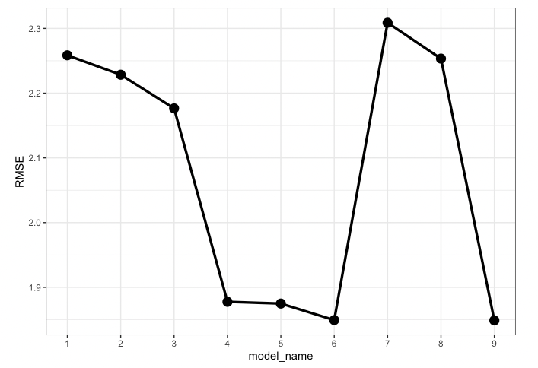
Regression model
Linear models
Since the value of the RMSE the smaller the better, the better model here is:
model_04, model_05, model_06, and model_09

Slide 10
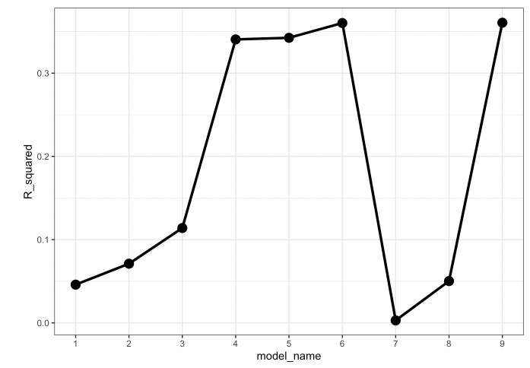
Regression model
Linear models
Since the value of the AIC and BIC the bigger the better, the better model here is:
model_04, model_05, model_06, and model_09

Slide 11
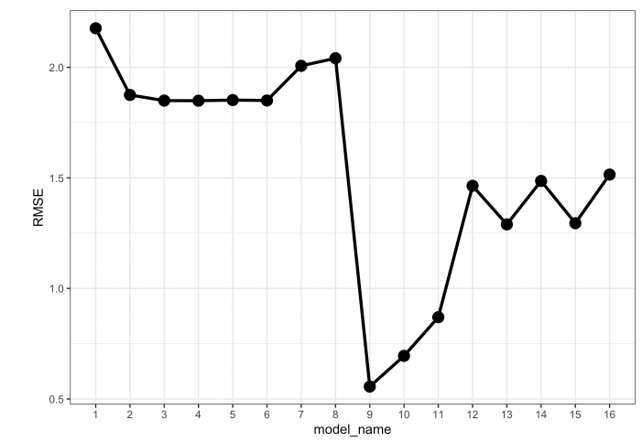
Regression model
After adding Baysian models, we found the model made by random forest has the best performance.
Since its RMSE is the smallest.

Slide 12
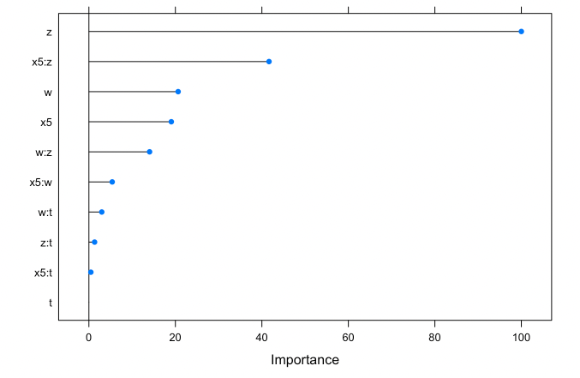
Regression model
The input z, is the most important input in this case.
Consequently, we can infer that,
the ratio of the chemistry:
z = (x1 + x2)/ (x4 + x5)
would have a relatively strong impact on the coat collision.

Slide 13
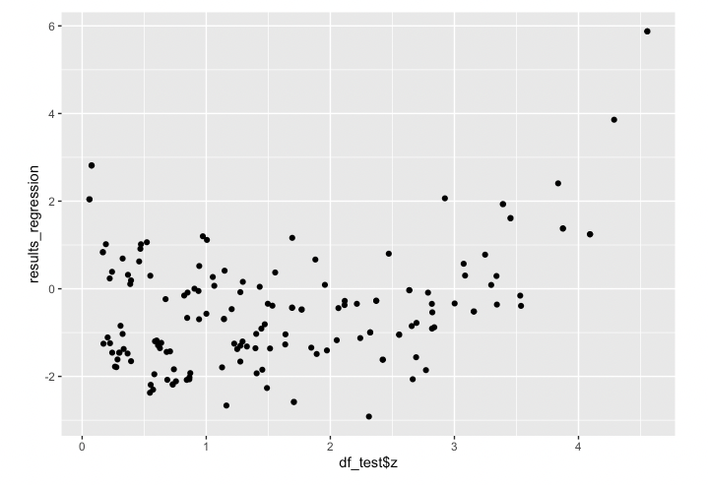
Regression model
This is our prediction result from our best model made by random forest

Slide 14
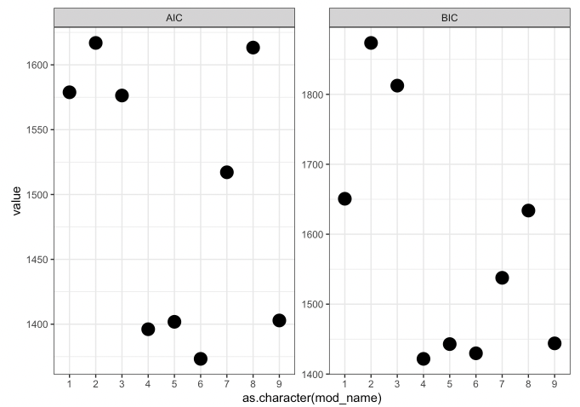
Classification model
Logistic regressions
Since the value of the AIC and BIC the smaller the better, the better model here is:
model_04, model_05, model_06, and model_09

Slide 15
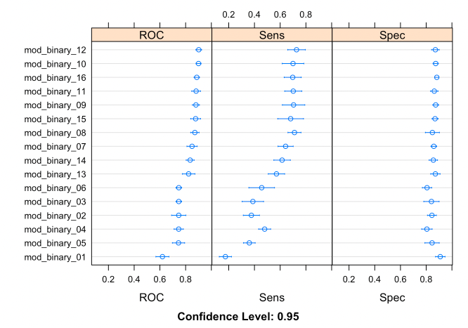
Classification model
After adding Baysian models, we found the model 12 is the best, since its ROC is the biggest.
And it is also made by random forest.

Slide 16
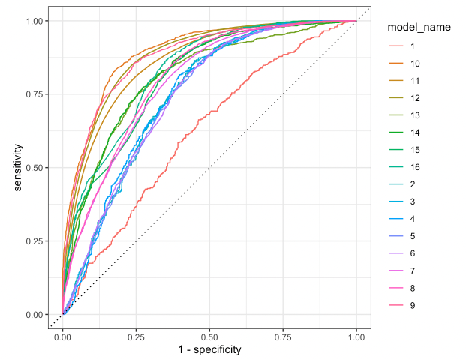
Classification model
After adding Baysian models, we found the model 10 is the best, since its ROC is the biggest.
And it is also made by random forest.

Slide 17
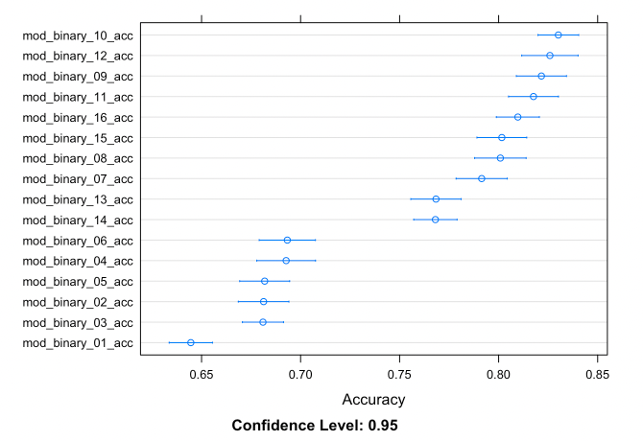
Classification model
After adding Baysian models, we found the model 10 is the best, since its Accuracy is the biggest.
And it is also made by random forest.

Slide 18
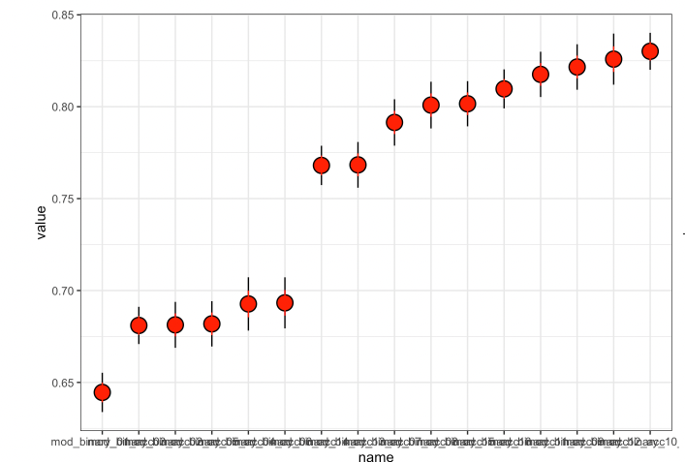
Classification model
After adding Baysian models, we found the model 10 is the best, since its Accuracy is the biggest.
And it is also made by random forest.

Slide 19
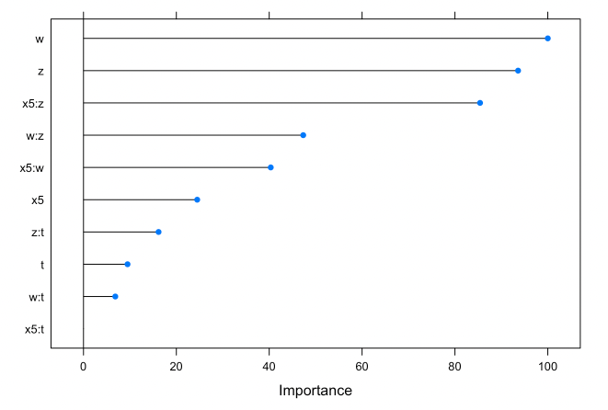
Classification model
The input z, is the most important input in this case.
Consequently, we can infer that,
the ratio of the chemistry:
w = x2/ (x3 + x4)
would have a relatively strong impact on the coat collision.

Slide 20
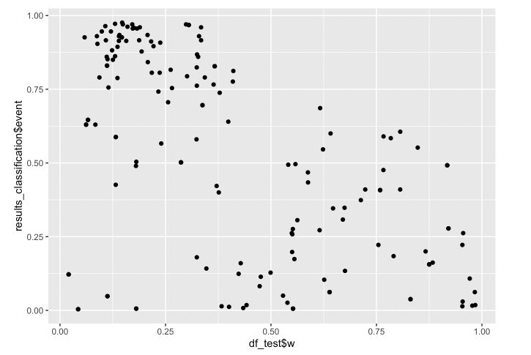
Classification model
This is our prediction result from our best model made by random forest

Slide 21
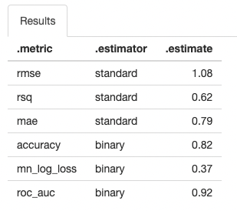
The performance of the model

Slide 22
Thank you for your watching!

